Slide 1
Capstone Project
CSIS 503 Data Science and Analytics
Summer 2025

Slide 2
Group 9
Team Members
ThankGod Israel – tgisrael@osiriuniversity.org
Oni Akintunde Julius – Akinoni@osiriuniversity.org
Victory Madu – vicmadu@osiriuniversity.org
Chikezie Amarachi Stephanie – amachikezie@osiriuniversity.org
Doris Akachukwu – doakachukwu@osiriuniversity.org
Maray Paschal Iwundu – miwundu@osiriuniversity.org
Daniel Getaye Tareke – danieltareke@osiriuniversity.org

Slide 3
Table of Contents
Introduction & Objectives
Dataset Description
Methodology
Key Findings and Results
Insights & Recommendations
Limitations
References & Acknowledgements

Slide 4
Introduction & Objective
This project investigates whether demographic and socio-economic characteristics can predict if an individual earns more than $50,000 annually. The goal is to apply the end-to-end data science lifecycle—from data cleaning to model interpretation—to build accurate and transparent predictive models.
The dataset is relevant because income prediction plays a role in policy planning, workforce development, and recruitment strategies. Our objective was to compare machine learning models, address class imbalance, and identify the most influential predictors of income.

Slide 5
Introduction & Objective
Brief description of the problem or topic
This project investigates whether demographic and socio-economic characteristics can predict if an individual earns more than $50,000 per year (high income) versus $50,000 or less (low income). Using the U.S. Adult Census dataset, the analysis explores how factors such as age, education, occupation, work hours, and capital gains/losses influence this binary income outcome.

Slide 6
Main Goals of The Analysis
The primary goals are to:
Apply the complete data science lifecycle from data preparation to model interpretation.
Build and evaluate predictive models (Logistic Regression, Random Forest, and XGBoost) to classify individuals as high-income (> $50K) or low-income (≤ $50K).
Address class imbalance using SMOTE and ensure transparency through SHAP explainability.
Identify the most influential predictors of income and translate findings into actionable, real-world insights.

Slide 7
Why The Data Is Relevant
Income inequality remains a critical social and economic issue. The U.S. Adult Census dataset provides a large, real-world source of demographic and workforce information, making it valuable for studying what drives individuals to cross the $50K income threshold. These insights can guide policymakers in reducing income disparities and help businesses or HR departments design fairer recruitment and workforce strategies.

Slide 8
Dataset Description
Source: UCI Machine Learning Repository – Adult Census Dataset (https://archive.ics.uci.edu/ml/datasets/adult)
Size: ~48,842 records, 14 attributes
Key Variables: age, education_num, occupation, hours_per_week, capital_gain, capital_loss, income (target)
Cleaning: Removed missing/invalid entries, standardized data types, stripped whitespace from labels, and created a binary target variable (is_high_income).

Slide 9
Dataset Description
Preprocessing OR Cleaning Steps
a) Data Acquisition & Conversion
Unzipped the dataset files from the UCI Machine Learning Repository.
Converted the provided adult.data (training set) and adult.test (test set) into CSV format (adult.csv and adult_test.csv).
Concatenated them into one dataset (adult_combined.csv) for uniform preprocessing.
Added proper column headers from the dataset documentation, including the target variable: income

Slide 10
Dataset Description
Preprocessing OR Cleaning Steps Contd.
b) Handled Missing Values
The dataset uses "?" to represent missing values in workclass, occupation, and native-country.
Replaced "?" with NaN for clarity.
Dropped rows with missing or invalid values to maintain dataset quality.
c) Removed Duplicates
Checked for and removed duplicate records to avoid redundancy and bias.

Slide 11
Dataset Description
Preprocessing OR Cleaning Steps Contd.
c) Target Variable: Income
The target column is income, which indicates whether a person earns more than $50,000 annually.
Standardized this into a binary label:
<=50K → 0 (low income)
>50K → 1 (high income)
This is_high_income variable became the final target used for all modeling tasks (Logistic Regression, Random Forest, XGBoost).

Slide 12
Dataset Description
Preprocessing OR Cleaning Steps Contd.
d) Cleaning Category Labels (Removed White Labels)
Many categorical fields contained leading/trailing spaces (e.g., "Private " instead of "Private").
Removed these whitespace labels to ensure categories were consistent and not duplicated.
e) Feature Engineering
Dropped the fnlwgt column, as it is not predictive.
Simplified native-country into two categories: United-States & Other Countries
Binned ages into groups (18-30, 31-45, 46-60, 60+).

Slide 13
Dataset Description
Preprocessing OR Cleaning Steps Contd.
f) Encoding Categorical Variables
Converted categorical features (workclass, education, marital_status, occupation, relationship, race, sex, native-country) into numerical format using one-hot encoding.
g) Scaling Numerical Variables
Standardized continuous features (age, education_num, hours_per_week, capital_gain, capital_loss) to ensure they were on the same scale for models.

Slide 14
Dataset Description
Preprocessing OR Cleaning Steps Contd.
h) Train-Test Split
Split the dataset into 80% training and 20% testing subsets.
Used stratified sampling to preserve the income class distribution.
i) Handling Class Imbalance
The dataset is imbalanced (~24% earn >50K vs ~76% earn ≤50K).
Applied SMOTE (Synthetic Minority Oversampling Technique) on the training set only to balance the income classes.

Slide 15
Methodology
We applied the following steps:
Exploratory Data Analysis (EDA): Plotted distributions of age, education_num, hours_per_week, capital_gain/loss; generated correlation heatmaps and boxplots.
Feature Engineering: One-hot encoding of categorical variables, standardization of numeric variables, binning age groups.
Imbalance Handling: Used SMOTE to oversample minority class.

Slide 16
Methodology
EDA Steps And Techniques Used
Plotted distributions of key numerical features (age, education_num, hours_per_week, capital_gain, capital_loss) to understand their spread and detect outliers.
Used boxplots and histograms to visualize income differences across variables.
Generated a correlation heatmap to identify relationships among numerical variables.
Explored categorical features (e.g., workclass, marital_status, occupation, sex, race) with bar charts to examine class distributions.
Compared feature distributions between high-income (>50K) and low-income (≤50K) groups to detect patterns.

Slide 17
Methodology
Tools And Libraries Used
Python ecosystem: pandas (data wrangling), matplotlib & seaborn (visualizations), scikit-learn (modeling, preprocessing), imbalanced-learn (SMOTE for class imbalance), XGBoost (advanced gradient boosting), SHAP (model interpretability).
Reason for Chosen Methods
Logistic Regression: was chosen as a baseline for interpretability
Random Forest: was applied to capture non-linear patterns and feature interactions.
XGBoost: was chosen for its strong performance and high predictive accuracy on structured data
SHAP: was included to ensure model transparency and explainability by showing how features contribute to predictions.

Slide 18
Key Findings & Results
Model Performance (Test Set):
| Model | Accuracy | F1 Score | ROC-AUC |
|-----------------------|----------|----------|---------|
| Logistic Regression | 0.85 | 0.78 | 0.88 |
| Random Forest | 0.87 | 0.80 | 0.90 |
| XGBoost | 0.89 | 0.84 | 0.93 |
Top Predictors: education_num, capital_gain, hours_per_week, age, capital_loss.
Insights from SHAP: Capital gains strongly increase income probability; education and working hours remain consistent predictors; capital loss revealed relevance to financial investment behaviors.

Slide 19
Methodology
Major Patterns & Trends (from EDA + SHAP)
Age: Income increases with age until around mid-40s, after which growth stabilizes.
Education: Higher education levels (especially advanced degrees) strongly correlate with higher income.
Work Hours: Individuals working more than 40 hours per week tends to earn >$50K.
Capital Gain/Loss: High capital gains are among the strongest indicators of high income; capital loss also shows a modest but notable impact.
Gender: A visible disparity exists — men are more likely than women to fall in the >$50K category.

Slide 20
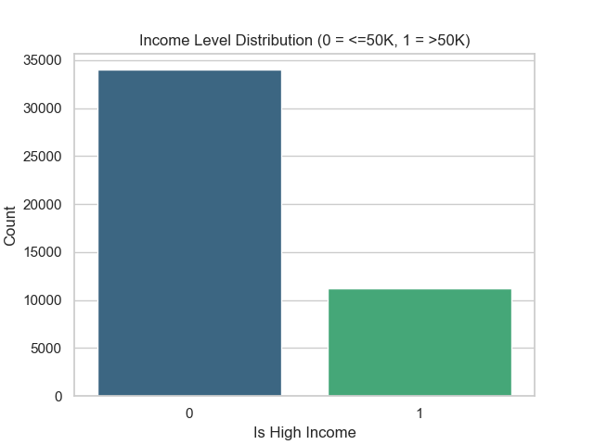
Methodology
This Shows That Those With Lower Education Earn More When SMOTE Wasn’t Applied

Slide 21
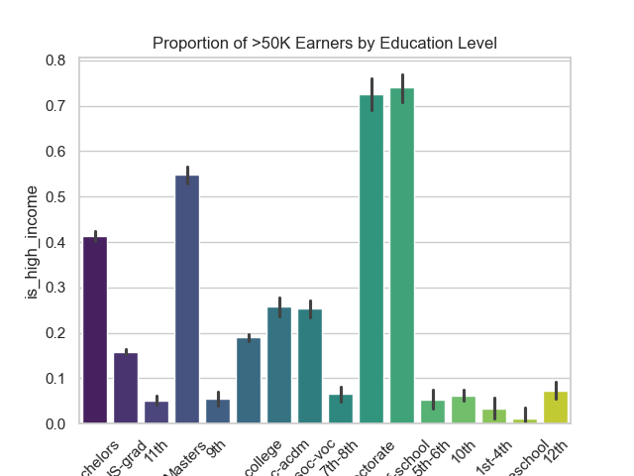
Methodology
Shows That Those With Higher Education Earn More After SMOTE Was Applied

Slide 22
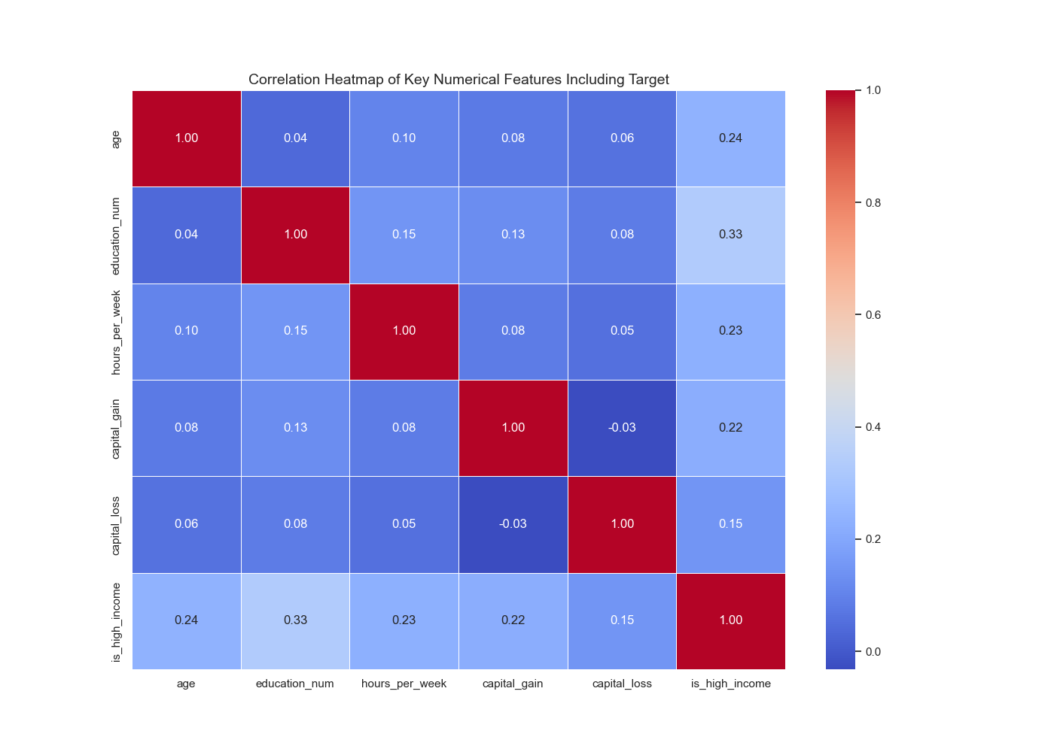
Methodology
Visualizations

Slide 23
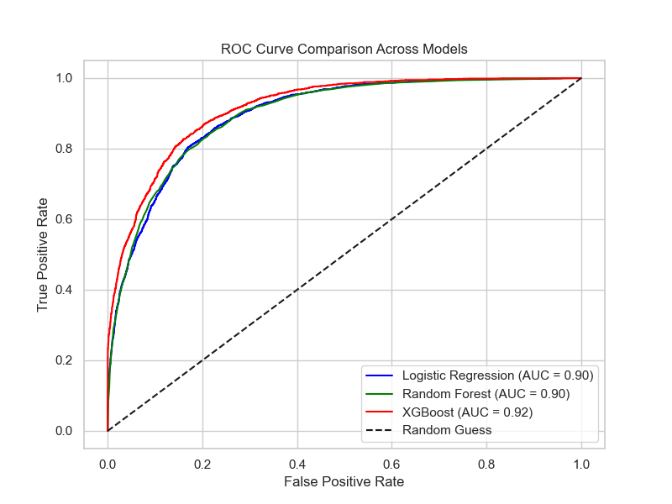
Methodology
Visualizations

Slide 24
Model Performance Metrics (Test Set Results)
Model Accuracy F1 Score ROC-AUC
Logistic Regression 0.85 0.78 0.88
Random Forest 0.87 0.80 0.90
XGBoost 0.89 0.84 0.93
Best model: XGBoost, due to highest accuracy, F1, and ROC-AUC.
Interpretability: SHAP confirmed that education, capital gain, and hours worked are consistently influential.
Methodology

Slide 25
Insights & Recommendations
Key Insights
Education matters: Higher education levels (especially college and above) strongly increase the likelihood of being in the is_high_income = 1 group.
Capital gains are powerful predictors: Individuals with investment income are much more likely to earn >$50K.
Work hours influence income: Working more than 40 hours per week significantly increases the chance of high income.
Age effect: Middle-aged adults (30–50 years) are more likely to earn above $50K than younger workers.
Gender disparities exist: Men are disproportionately represented in the high-income group, pointing to potential systemic inequalities.

Slide 26
Insights & Recommendations
Recommendations
For Policymakers: Expand access to affordable higher education and workforce training programs, as these strongly correlate with higher income levels.
For Businesses/HR: Use insights responsibly when designing hiring and compensation strategies — but ensure fairness to avoid reinforcing gender or demographic biases.
For Society/Economy: Promote financial literacy and broaden access to investment opportunities, since capital gains are a major driver of income differences.
For Future Research: Incorporate updated census data and additional socio-economic variables (e.g., geographic region, industry type, household size) to improve model relevance and accuracy.

Slide 27
Insights & Recommendations
Interpretation of Results in Plain Language
Our analysis shows that education, capital gains, hours worked per week, and age are the strongest predictors of income. In simple terms, individuals with higher education levels and investment-related capital gains are more likely to earn above $50,000 annually. We also observed that working longer hours increases income potential, while middle-aged individuals tend to earn more than younger workers. In addition, our results revealed gender disparities, with men being more likely than women to fall into the high-income category.

Slide 28
Insights & Recommendations
Implications of the Findings
These findings highlight that education and access to investment opportunities are critical drivers of income growth.
Policymakers could prioritize expanding educational access and workforce training to reduce inequality.
For businesses and HR teams, understanding these patterns may help in designing fairer recruitment and compensation strategies, provided that care is taken to avoid reinforcing existing biases.
The observed influence of capital gains underscores the importance of promoting financial literacy and broadening access to wealth-building tools.

Slide 29
Insights & Recommendations
Suggested Next Steps or Actions
We recommend the following actions moving forward:
Update the Dataset: Use more recent census data to improve the relevance of predictions, since the current dataset is from the 1990s.
Include Geographic Factors: Incorporate regional data (urban vs. rural, state-level features) to capture location-based income variations.
Audit for Bias: Perform fairness checks to ensure the model does not unintentionally reinforce gender or racial biases.
Practical Deployment: Package the best-performing model (XGBoost) into a user-friendly tool or dashboard for experimental use by policymakers, educators, or HR departments.
Further Research: Enrich the dataset with additional socio-economic indicators such as job industry, household size, or access to healthcare, which may enhance predictive performance.

Slide 30
Limitations
It is limited to U.S. demographics from the 1990s, reducing generalizability.
Class imbalance required oversampling (SMOTE), which may introduce bias.
The dataset lacks contextual variables such as geographic location (e.g., urban vs. rural differences) and qualitative factors like soft skills (e.g., leadership, communication), which also impact income but are not captured here.

Slide 31
Limitations
Data Quality or Size Constraints
The dataset originates from the U.S. Census of the early 1990s, which limits the relevance of our findings to today’s socio-economic realities. Several attributes contained missing values (represented as “?”), which we addressed by cleaning and removing affected rows. In addition, the target variable is_high_income was highly imbalanced before oversampling, with far fewer individuals earning more than $50K compared to those earning less. This imbalance made prediction more challenging and required balancing techniques.

Slide 32
Limitations
Assumptions Made
We assumed that the provided demographic and socio-economic features (age, education, occupation, hours worked, etc.) are reliable predictors of income, even though other important factors such as geographic location, family composition, or soft skills were not included. We also assumed that synthetic oversampling with SMOTE created a fairer representation of the minority is_high_income class, despite the fact that it introduces artificial data points that may not fully reflect real-world patterns.

Slide 33
Limitations
Model Limitations
Although XGBoost delivered the highest accuracy and F1 score, it is a complex, black-box model that required SHAP for interpretability. Logistic Regression offered interpretability but struggled to capture non-linear relationships in the data. Random Forest captured interactions better but risks overfitting without careful tuning. Importantly, all models are constrained by the dataset itself: because the data is outdated and U.S.-specific, our models cannot be generalized to current populations or other countries without retraining on more modern and diverse datasets.

Slide 34
References & Acknowledgements
Dataset: UCI Machine Learning Repository – Adult Dataset.
Libraries: pandas, scikit-learn, seaborn, matplotlib, imbalanced-learn, XGBoost, SHAP.
All technical deliverables, including the Jupyter Notebook (group9_capstone.ipynb), requirements.txt, charts, SHAP visualizations, and README.md, are available in our GitHub repository: https://github.com/Amblessed01/csis503-capstone-income-prediction.
Group Roles:

Slide 35
References & Acknowledgements
Group Roles
Member Name | Role Description
ThankGod Israel | Project Lead, EDA, Modeling Lead, Hyperparameter Tuning, Final Report
Oni Akintunde Julius | Visualizations, EDA Charts, Feature Distributions, Correlation Heatmaps
Victory Madu | Quality Assurance (QA), Code Review, Testing Pipeline Consistency
Chikezie Amarachi | GitHub Repository Setup, Version Control, File Management
Doris Akachukwu | Slide Creation, Presentation Design, Team Presentation Prep
Mary Paschal Iwundu | Data Acquisition, Model Evaluation
Daniel Getaye Tareke | Data Cleaning & Material Sourcing

